Slide 1

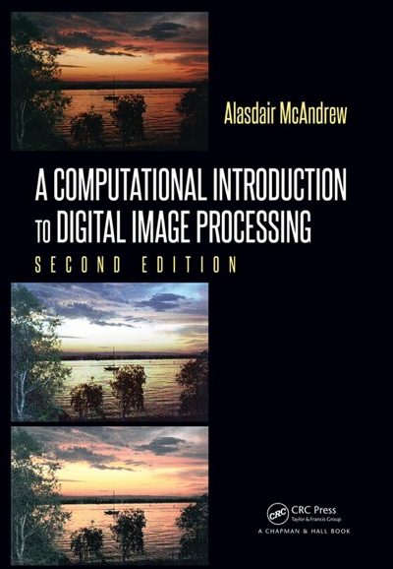
Chapter 3
Image Display

Slide 2

Image Display
Factors that influence image display include:
1. Ambient lighting
2. The monitor type and settings
3. The graphics card
4. Monitor resolution

Slide 3
imshow Function
imshow can display images stored in a matrix of type:
uint8
uint16*
double with all values in the range 0.0 – 1.0
Note: Any image processing that produces an output of type double must either be scaled to the range 0-1 or converted to type uint8 before display. If scaling is not done, then imshow will treat all values greater than 1 as white, and all values lower than 0 as black.
*Octave requires the underlying ImageMagick library is compiled to handle 16-bit images for uint16.

Slide 4
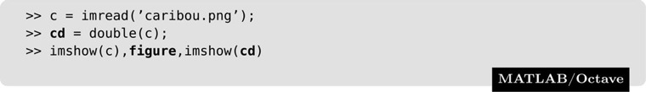
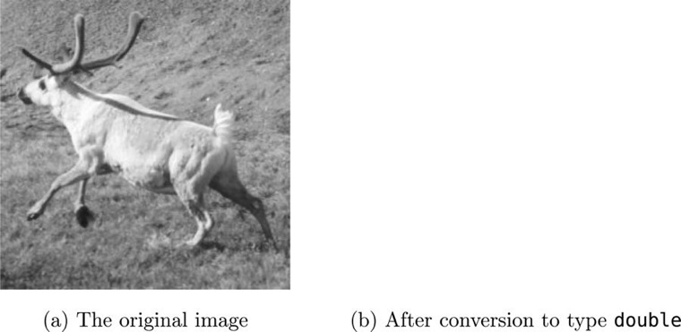
imshow Function
Any original values that were greater than 1 are now being displayed as white.

Slide 5
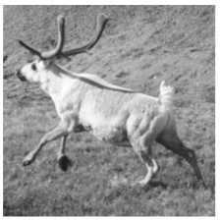
imshow Function
Scale matrix to the range 0–1:

Slide 6
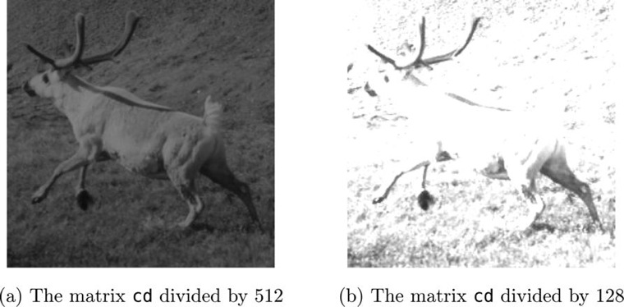
imshow Function
Vary the display by changing the scaling of the matrix:

Slide 7

imshow Function
im2double: Applies correct scaling so that the output values are between 0 and 1.
double changes the data type but does not change the numeric values;
im2double changes both the numeric data type and the values.

Slide 8

imshow Function
Convert back to an image of type uint8 in two ways:

Slide 9
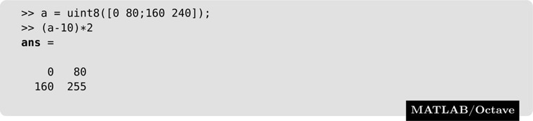
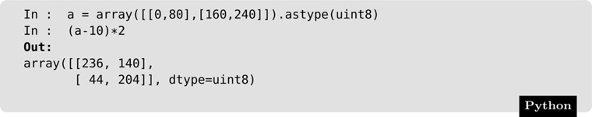
imshow Function
MATLAB/Octave and Python differ in their handling of arithmetic on uint8 numbers. For example:
ans =
0 140
255 255
MATLAB and Octave clip the output, so that values greater than 255 are set equal to 255, and values less than 0 are set equal to zero. But in Python the result is different:
Python works modulo 256: numbers outside the range 0–255 are divided by 256 and the remainder given.

Slide 10
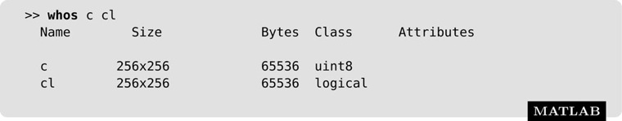
Binary Images
A binary image will have only two values: 0 (black) and 1 (white)
MATLAB and Octave do not have a binary data type as such, but they do have a logical flag, where uint8 values as 0 and 1 can be interpreted as logical data.
Convert from grayscale to binary:
Use the whos command to see variables and datatypes:

Slide 11
Bit Planes
Bit Plane: A set of bits corresponding to a given bit position in each of the binary numbers representing the image.
% isolate the n-th rightmost bit from every element in x
bitget(x, 1) least significant bit plane
bitget(x, 8) most significant bit plane

Slide 12
Bit Planes
Bit Plane: A set of bits corresponding to a given bit position in each of the binary numbers representing the image.
will isolate the n-th rightmost bit from every element in x
Example:
1st 5 bytes of an image
bit plane 1: 1 0 1 1 1
bit plane 2: 1 0 0 0 1
bit plane 3: 0 0 0 0 1
bit plane 4: 0 0 0 0 1
bit plane 5: 0 0 0 0 1
bit plane 6: 0 0 0 0 1
bit plane 7: 1 1 1 1 0
bit plane 8: 0 0 0 0 0
Decimal:
Binary:
67
64
65
65
63
01000011
01000000
01000001
01000001
00111111

Slide 13
Bit Planes
function showbitplanes(f)
% read image data from file into matrix
pic = imread(f);
% create x and y positions for each subplot
posx = [0 1 2 0 1 2 0 1]/3;
posy = [2 2 2 1 1 1 0 0]/3;
% Graph 8 bit planes from least significant to most significant
for i = 1:8
% position requires left, bottom, width, and height specifications
subplot('position', [posx(i), posy(i), 0.3, 0.3]),
imshow(logical(bitget(pic, i))), axis image
end

Slide 14
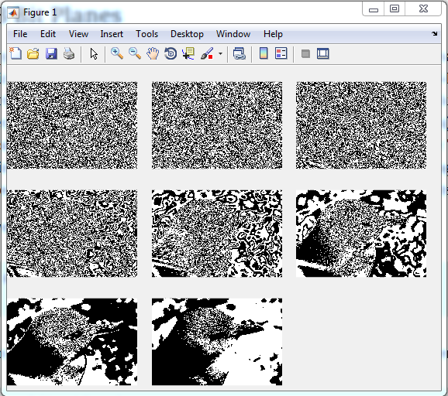

Slide 15
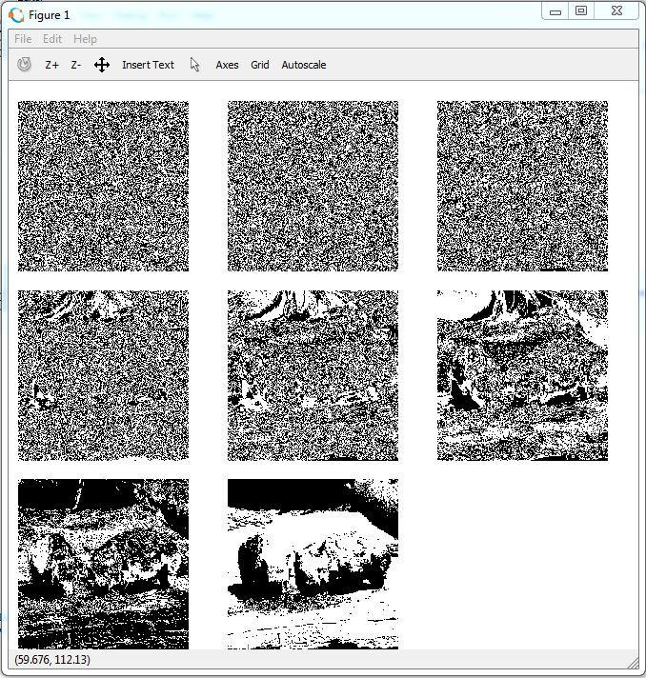

Slide 16
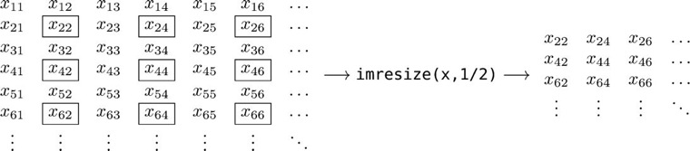
Spatial Resolution
Spatial Resolution: The density of pixels over the image. The greater the resolution, the more pixels are used to display the image.
Part of Image Processing Toolbox

Slide 17
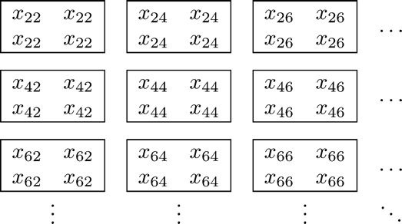
Spatial Resolution
If we apply imresize to the result with the parameter 2 and the method “nearest,” rather than 1/2, all the pixels are repeated to produce an image with the same size as the original, but with half the effective resolution in each direction:
Part of Image Processing Toolbox

Slide 18
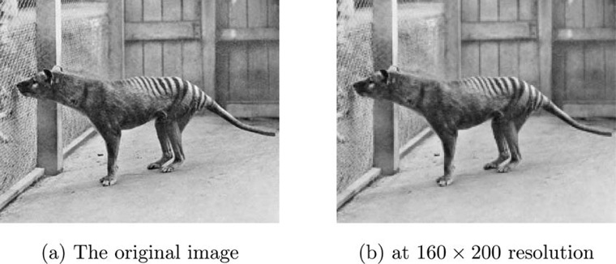
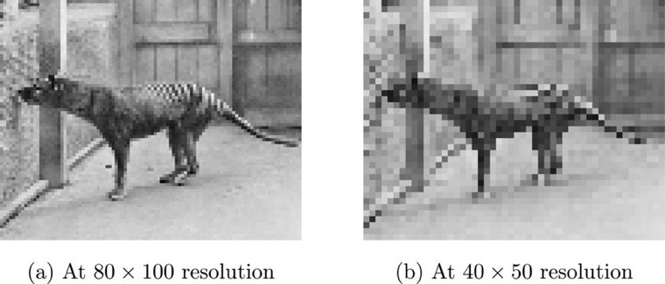
Pixelization
Increasing blockiness or pixelization become quite pronounced as the resolution decreases
This is a famous image showing the last known thylacine, or Tasmanian Tiger, a now extinct carnivorous marsupial, in the Hobart Zoo in 1933.

Slide 19
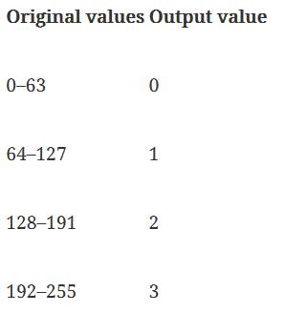
Quantization
Quantization: The process of mapping a set of input values to a smaller set.
Uniform Quantization: Representing an image with only n grayscales by dividing the range of grayscales into n equal (or nearly equal) ranges, and mapping the ranges to the values 0 to n − 1

Slide 20
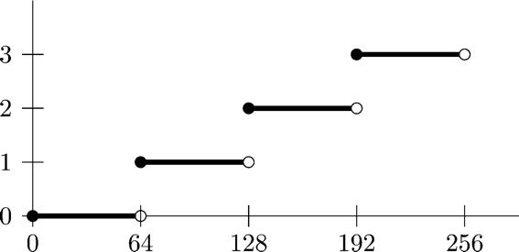
Uniform Quantization
Since f is of type uint8, dividing by 64 will also produce values of type uint8; so any fractional parts will be removed. For example:

Slide 21
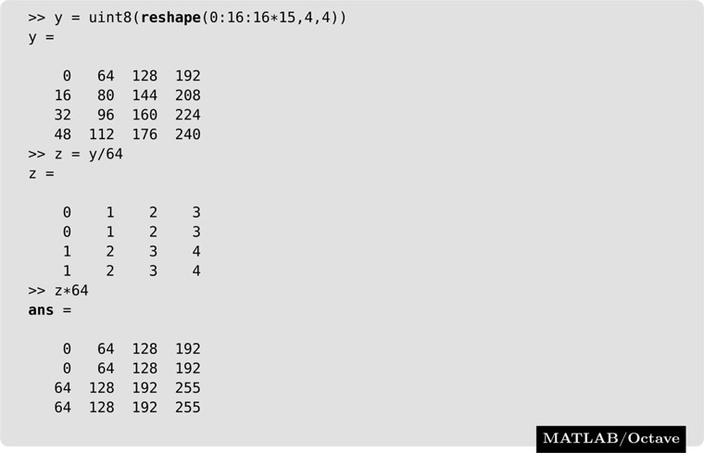
Uniform Quantization
Notice that MatLab & Octave round; Python (similar to C++) returns the floor.
The original array has now been quantized to only five different values.
x = uint8(0:16:16*15)
x =
Columns 1 through 14
0 16 32 48 64 80 96 112 128 144 160 176 192 208
Columns 15 through 16
224 240

Slide 22
Uniform Quantization
Given a uint8 array x, and a value v, then in general the command
Produces a maximum of 256/v+1 different possible grayscales. So with v = 64 as above, we would expect 256/64 + 1 = 5 possible output grayscales.

Slide 23
Uniform Quantization
To precisely specify the number of output grayscales, then we can use the grayslice function.
Given an image matrix x and an integer n, the MATLAB command grayslice(x, n) produces a matrix whose values have been reduced to the values 0, 1, …, n − 1.
will produce a uint8 version of our image with values 0, 1, 2 and 3. Note that Octave works slightly differently from MATLAB here; Octave requires that the input image be of type double:

Slide 24
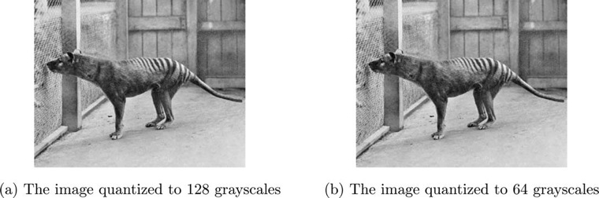
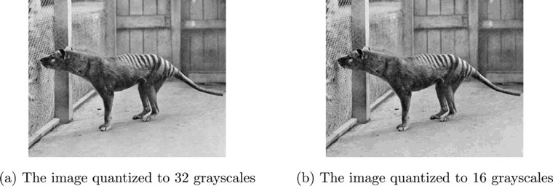
Uniform Quantization

Slide 25
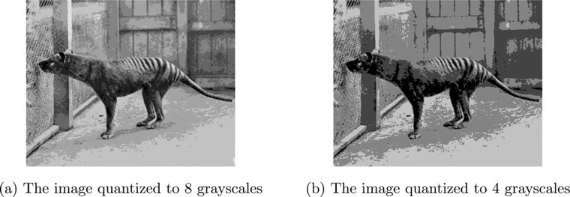
False Contours
Uniform quantization can result in “false contours,” most noticeable with fewer grayscales.
Notice that the ground and rear fence gray texture is no longer smooth; there are observable discontinuities between different gray values.

Slide 26
Dithering
Dithering: A quantization method that reduces false contouring.
Preferred over uniform quantization when the number of colors are limited
Ex. Newsprint has only two scales, black and white, referred to as halftoning.
Basic idea: Use a cluster of pixels to represent intensity such that density of black dots in the new image approximates the average gray level in the original.

Slide 27
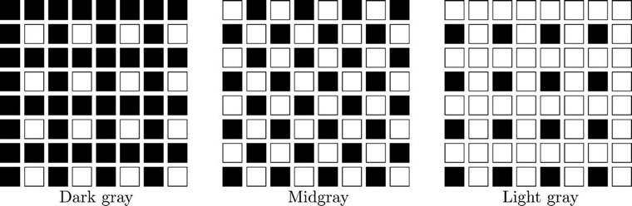
Dithering

Slide 28



Dithering
Standard dithering matrices:
Matrix values are repeated until the dithering matrix is as large as the original image.
Given d(i,j) is the replicated dithering matrix and x(i,j) is the original matrix, an output pixel p(i,j) is defined by:

Slide 29
Dithering
From MatLab, help repmat:
repmat Replicate and tile an array.
B = repmat(A,M,N) or B = repmat(A,[M,N]) creates a large matrix B
consisting of an M-by-N tiling of copies of A. The size of B is
[size(A,1)*M, size(A,2)*N].

Slide 30
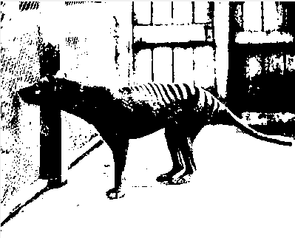
Dithering
Uniform Quantization:
>> x = imread('thylacine.png');
>> x2 = (x/256)*256;
>> imshow(x2);

Slide 31
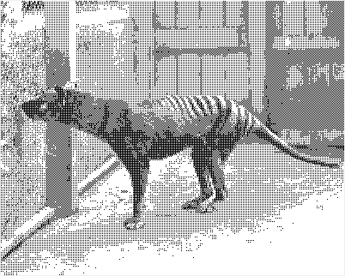
Dithering
Dithering, D = [0 128; 192 64]:
>> x = imread('thylacine.png');
>> D = [0 128; 192 64];
>> r = repmat(D, 160, 200);
>> x2 = x > r;
>> imshow(x2);

Slide 32
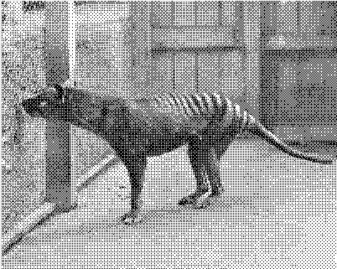
Dithering
Dithering, D2 = [0 128 32 160; 192 64 224 96; 48 176 16 144; 240 112 208 80];
>> x = imread('thylacine.png');
>> D2 = [0 128 32 160; 192 64 224 96; 48 176 16 144; 240 112 208 80];
>> r2 = repmat(D2, 80, 100);
>> x4 = x > r2;
>> imshow(x4);

Slide 33


Dithering
Uniform Quantization Dithering, D Dithering, D2
Note: These are all strictly binary images; dithering fools the eye into seeing shades of gray.

Slide 34
Error Diffusion
Error Diffusion: A quantization method that takes into account the error between its gray value and its quantized value.
Book provides additional information, as well as error-diffusion functions.

